Slide 1

PROJECT TITLE – SEASONAL AGRICULTURE PERFORMANCE ANALYSIS
NAME : UJJWAL GUPTA
AICTE STU ID : STU68374882bc9891748453506
AICTE INTERNSHIP ID : INTERNSHIP_17830691666a4779eecfe8a

Slide 2

PROBLEM STATEMENT
Agricultural activities face huge performance variations due to seasonal changes in environment and markets.
Seasonal Variations: Conditions fluctuate dramatically across seasons.
Performance Fluctuations: Farm success differs between cycles.
Data Limitations: Raw numbers hide critical trends.
Analytical Goal: Uncover patterns using data analytics.

Slide 3
PROJECT DESCRIPTION
.
Core Dataset: Farm-level records of 4,000 observations across 28 distinct features.
Features Analysed:
Environmental: Rainfall, temperature, soil moisture, and pH.
Operational: Fertilizer/pesticide inputs, water usage, and seed quality.
Financial: Crop yields, market price, total cost, revenue, and net profit.
Analytical Focus: Exploratory data analysis (EDA) and bivariate profiling to uncover hidden seasonal trends without using machine learning.

Slide 4

WHO ARE THE END USERS?
Farmers & Cooperatives: Helping them make informed decisions on resource allocation based on seasonal trends.
Agronomists & Researchers: Aiding their understanding of crop vulnerabilities to seasonal weather shifts.
Agricultural Policymakers: Providing data-backed insights for planning regional support, subsidies, and market interventions.

Slide 5

TECHNOLOGY USED
Google Colab: Cloud-based Jupyter Notebook environment used for executing the entire data analytics workflow.
Python: Primary programming language used for data manipulation, statistical analysis, and plotting.
Pandas & NumPy: Core libraries applied for dataset cleaning, missing value imputation, and aggregating 4,000 farm records.
Seaborn & Matplotlib: Visualization tools used to design clean statistical charts like seasonal box plots, heatmaps, and counts.

Slide 6
RESULTS
Kharif Season Highs: Records the highest financial returns with an average gross revenue of ₹710,719 and a net profit of ₹178,914.
Rabi Season Stability: Represents a stable, reliable farming cycle characterized by a moderate average net profit of ₹87,689.
Zaid Season Deficit: Experiences severe operational and financial strain, resulting in an average net loss of ₹24,804 per farm.
Profitability Drivers: Bivariate analysis proves net profit is limited more by high seed costs and market price shifts than fertilizer inputs.

Slide 7
RESULTS
Zaid Resource Stress: Suffers from severe water inefficiency, requiring a massive average irrigation volume of 6,419.89 m³.
Kharif Disease Exposure: Faces the highest environmental vulnerability with pest and disease risk thresholds spiking to 54.47%.
Soil Health Balance: Excess chemical fertilizer use fails to boost crop yields and actively degrades baseline soil pH levels.
Environmental Limits: High summer temperatures during Zaid (averaging 31.04°C) directly drive down soil moisture to a low 19.28%.

Slide 8
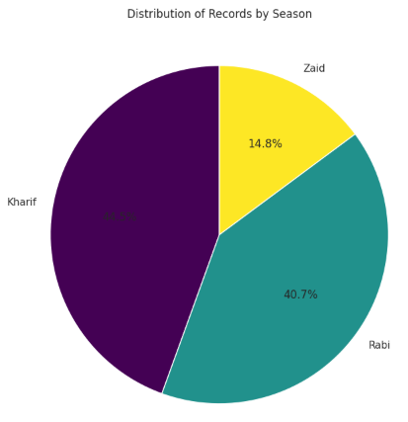
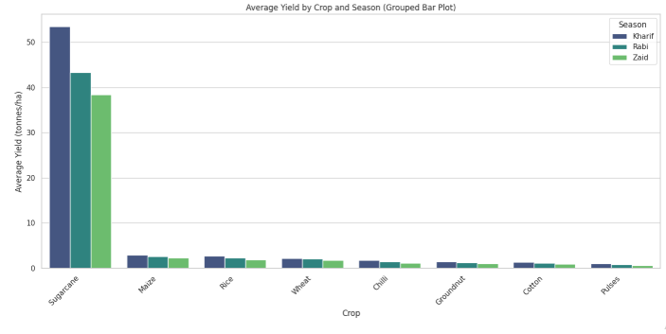
RESULTS

Slide 9
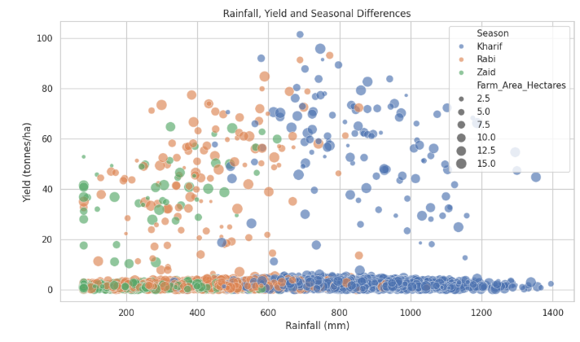
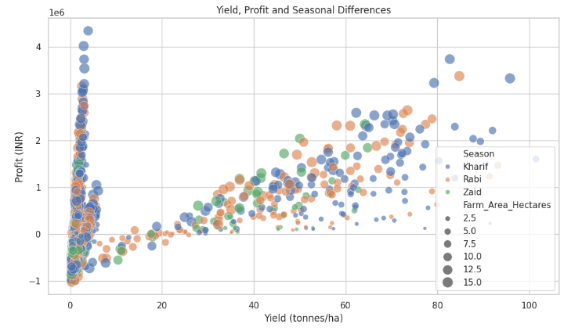
RESULTS

Slide 10
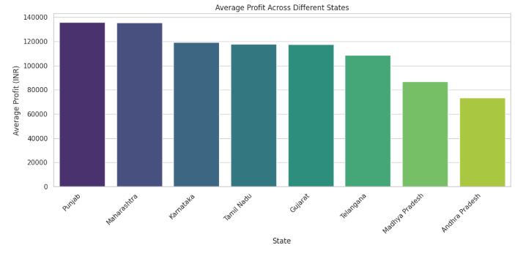
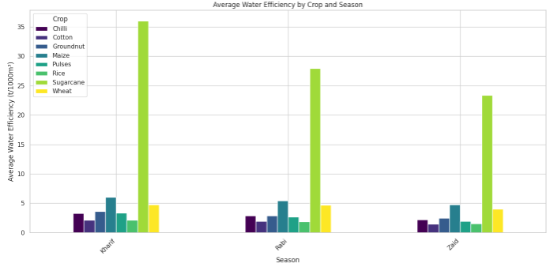
RESULTS

Slide 11
FUTURE SCOPE
Predictive Yield Modeling: Apply machine learning regressors to forecast future crop yields based on environmental factors.
Interactive Analytics Dashboard: Develop a web-based Streamlit application to display real-time seasonal insights and farm trends.
Resource Optimization Engine: Design an automated system to provide targeted fertilizer and irrigation recommendations using soil data.
Early Disease Warning System: Create anomaly detection triggers to flag high pest and disease risk periods automatically.

Slide 12
GITHUB LINK
https://github.com/ujjwalgupta2021/VOIS-Data-Analytics/tree/main/Major%20Project-Seasonal%20Agriculture%20Performance%20Analysis
Click Here

Slide 13
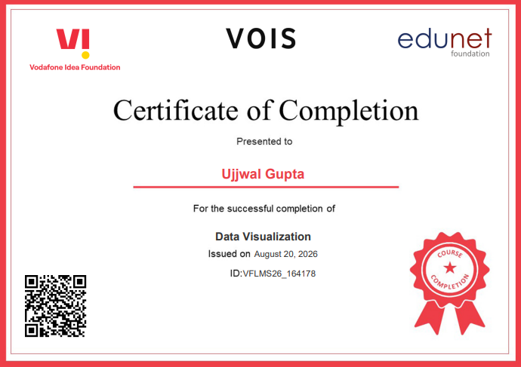
VOIS COURSE COMPLETION CERTIFICATE - COURSE NAME- DATA VISUALIZATION

Slide 14
THANK YOU
.
.

